Slide 1
Enterprise Team Foundation Server
Overview
Mike O’Brien
2016

Slide 2
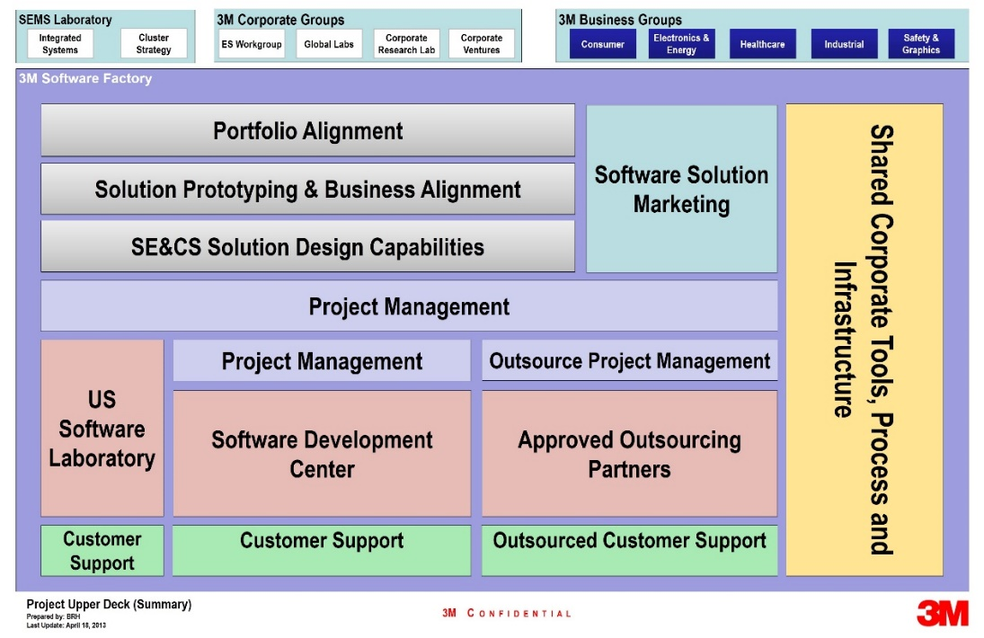
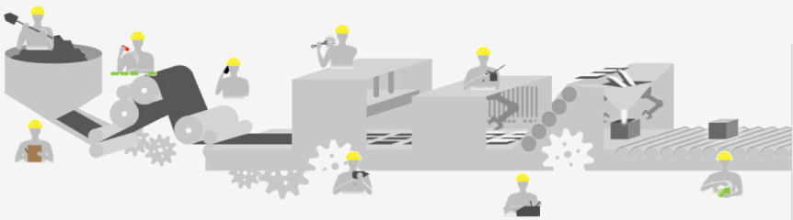











3M Software Factory – Software Engineering for the Future
Building the software engineering capabilities needed to enable rapid, high-quality and profitable product development.
Specialized Software Skillsets
Software Process Development
State of the Art Software Infrastructure
Divisions + ES Workgroup
Goal
Provide an Enterprise ALM Service for all 3M Software teams.

Slide 3
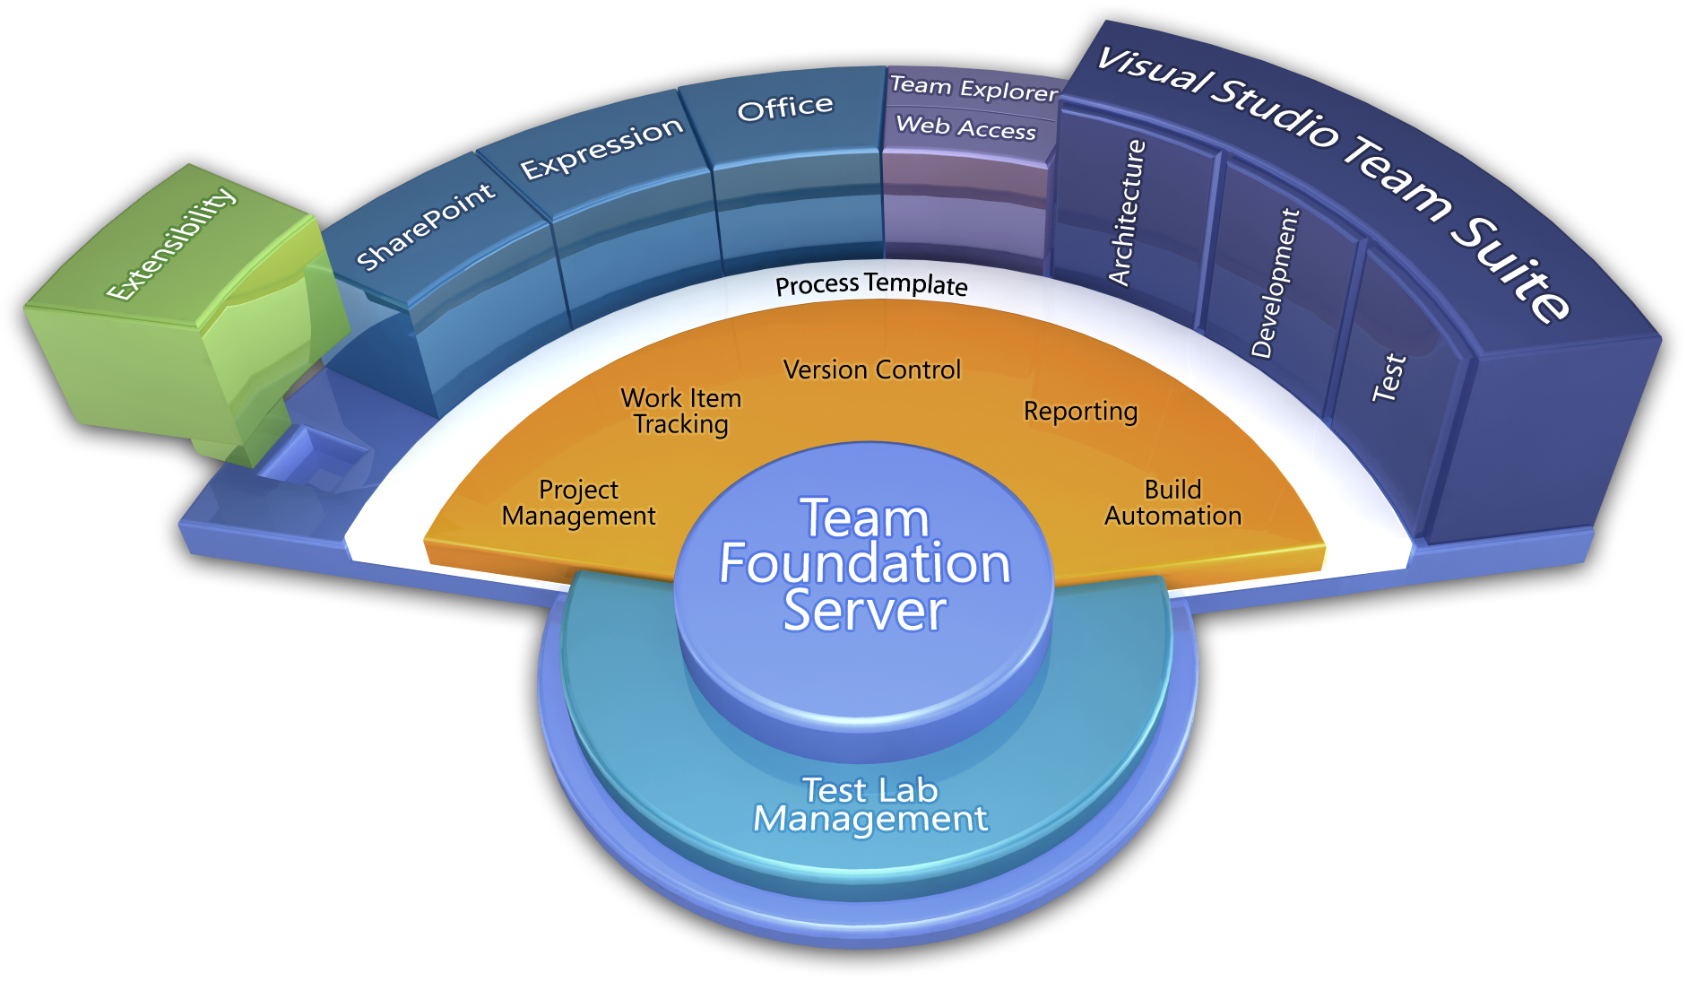
What is Team Foundation Server (TFS)?
Team Foundation Server is a Microsoft product which provides source code management, reporting, requirements management, project management, automated builds, lab management, testing and release management capabilities.
Process / Optimization
Project Management
Requirements Management
Design & Architecture
Release Management
Development
QA & Test
Application Lifecycle Management (ALM)
Application Lifecycle Management using Visual Studio Team Foundation Server provides proven practices to manage application lifecycle. Manage source code across teams; develop, build, and test applications; plan projects, track work, and report progress.

Slide 4
What is 3M Enterprise TFS (ETFS)?
ALM service for all 3M software teams
Infrastructure hosted in 3M Data Centers
High Availability install of Team Foundation Server
Load Balanced across multiple machines
99.9% predicted uptime
System Support 24x7x365 via 3-1000 or http://ithelp.mmm.com
Backups follow 3M standards for data retention
Dedicated Export Control instance
Training Available for TFS and Scrum
Developers
Project Managers/ScrumMasters
Product Owners
Testers
Stakeholders

Slide 5
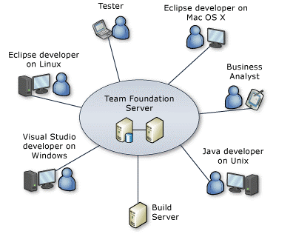
ETFS – Cross Platform
ETFS provides support for clients of differing OS's and platforms. If you can use a web browser, you can use ETFS to manage a Team Project.​
Build machines are available for Windows, OSX, and Linux. If an OS can run NodeJS, you can run it as a build machine within ETFS.
Release Management capable of publishing to local machines, 3M IT Data Centers, and Cloud (Azure, Chef, Puppet, etc).

Slide 6
ETFS Team Structure
Service Manager
- Initial contact of new teams
- Provide training
- Maintain relationship with teams
Operations (Ops)
- IT Operations Team (IT Commercial Software & Hosting Services)
DevOps
- Team onboarding tasks
- Service enhancements
- Test updates/upgrades, update documentation
- Perform DevOps role for SEMS and Division teams as needed
- ETFS System Maintenance
- Respond to support requests
- Focused on PROD system

Slide 7
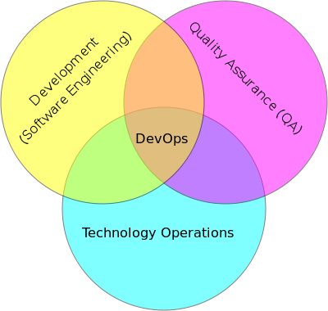
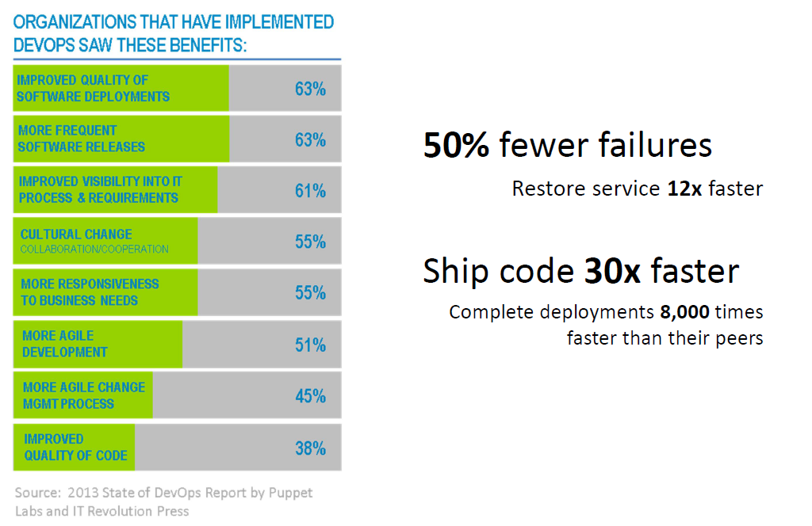
SEMS DevOps
SEMS DevOps Role on ETFS
ETFS - Team Onboarding and Migration
ETFS - Service Enhancements
Build (Windows and Cross Platform)
Release Management Deployment
Reporting
SEMS DevOps Capabilities
Source code structure (release management, branching, merging)
Versioning (configuration management)
Automate builds – CI and release
Automate Deployment to Dev, QA, and Prod (Release Management)
Automate Testing
Notes:
“Automate Everything”

Slide 8
Technology Platform and Roadmap
Requirements
Authoring Requirements document with Enterprise defined structure, methodology, and process
Cloud Hybridization
Cross Platform Builds
(iOS / Xamarian / Android / Linux)
Rollup Reporting
(self-service reporting portal)
Value Added
DevOps
Automated build, deploy and testing harnesses
Enterprise Software Development Process
Process Template
Project Management
Requirements Management
Version Control
Test Case Management
Build Automation
Reporting
TFS Technology
Platform
TFS

Slide 9
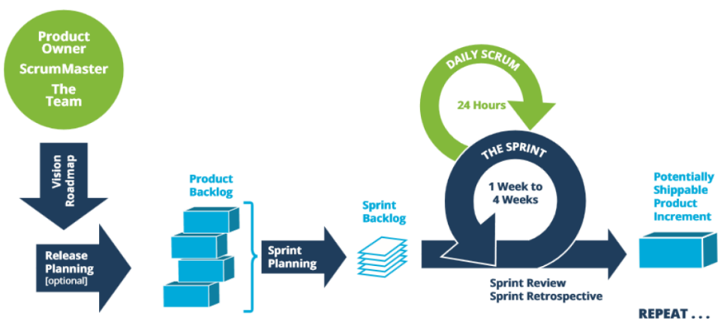
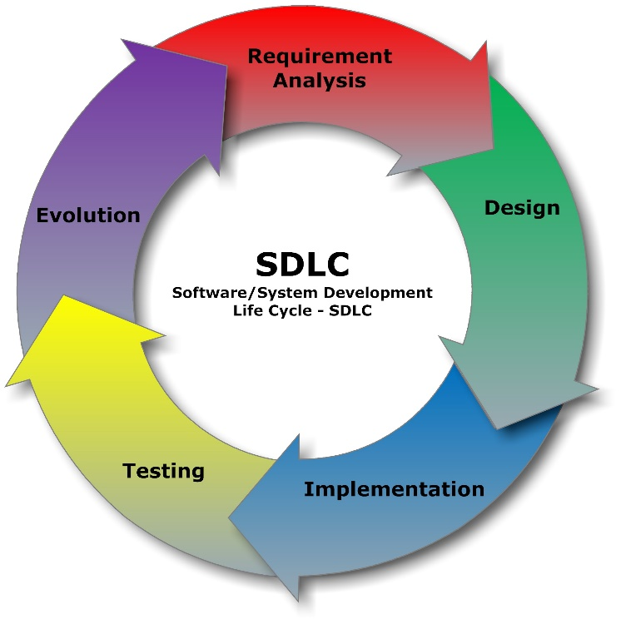
Process Support
Scrum
Support the Scrum Process and Ceremonies
Customizations for Agile Portfolio Management
Enterprise scalable
CMMI (Waterfall)
Microsoft supplied Process Template with Enterprise scalable modifications
Streamline SDLC (Medical Device)
Custom process template in development to support the Healthcare Quality System
Notes:
“Automate Everything”

Slide 10
ETFS Architecture – QA and PROD

Slide 11
ETFS Environments
DEV
tfsdev.mmm.com
QA
tfsqa.mmm.com
PROD
tfs.mmm.com
Team Projects are ‘disposable’
Flexible on permissions
Create multiple team projects – if needed
Prototype TFS Customizations
Process Template customizations
Permissions / Groups / Teams
Trial of 3rd Party Tools
Upgrade Testing
First target for TFS Updates and / Upgrades
Staging for PROD
Test Migration Plan
Identical in performance to PROD
Perform source migration test
Staging for TFS Updates & Upgrades
1. Team Projects
Permanent home
Final target of Migration
Process Template changes – subject to ETFS Change Board approval

Slide 12

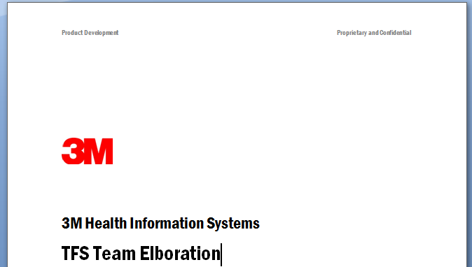
ETFS Onboarding Workflow
Continuously re-evaluate the onboarding process
Enroll
Elaboration
Training
Migration
Adoption
Team Identification…
Workflow requirements
Workflow customizations
Source control requirements
Build/CI requirements
Delegate task to gather team members and define sub-teams
Delegate task to define areas
Delegate task to define sprint schedule
Identify Team Interdependencies
Delegate Licensing Inventory
Schedule…
Timeframes
Training
Materials…
TFS Getting Started Guide*
Scrum Primer*
Requirements
Prioritize
Match to solutions
Add team to queue
Find possible scenario(s)
Migration Plan
Workflow Scenarios
Representative Migration
Technical Scenarios
Migration
Snapshot Migration
Source Migration
Archive Availability
General TFS Training
Developer TFS Training
Project Management Training
Test Manager Training (optional)
Data Migration
Calculate production impact
Respond to environment issues
Monitor
Re-evaluate
Impact
Time
Scenario Time
Downtime
Environment
Support
Maintenance
Follow up training
Process
Part-time
Ongoing
Refer to “TFS Team Elaboration Details”
Refer to “Migration Guidance and Readiness”
* = In Progress

Slide 13
Governance
August 2015 - ETFS Governance established
ETFS Change Board meets monthly
http://tfs.mmm.com/governance
Notes:
“Automate Everything”

Slide 14

Technology Roadmap
Build Services - Enterprise Build Farm
Native Build machines (Windows / .Net / Visual Studio)
Cross Platform Builds – Java/Android, iOS
Static code analysis (Security scan, technical debt) using HP Fortify and Sonarqube
Rollup Reporting - Enterprise Reporting
Reports across Team Projects / Businesses / Divisions
Deployment Services
Automate Build, Configuration, Deployment, Testing, and Production Environments
Notes:
“Automate Everything”

